Slide 1
Sales Financial Dashboard
INTERN NAME: FIROZ NOUSHAD MAHAT

Slide 2
Executive Summary
Total Sales: 118.73M
Total Profit: 16.89M
Total Quantity Sold: 1.13M
COGS (Cost of Goods Sold): 101.83M
Products Analyzed: 700
Period: 2013–2014

Slide 3
Sales by Customer Segment
Visual: Pie chart from dashboard
Breakdown:
Government: 52.5M (44.22%)
Enterprise: 42.43M (35.74%)
Small Business: 19.61M (16.52%)
Midmarket, Channel Partners: Remaining minor percentages
Key Insight: Government and Enterprise are the largest segments.

Slide 4
Sales & Profit by Product
Visual: Clustered bar chart (Sales vs. Profit by product)
Details:
Paseo: 33M Sales, 4.8M Profit
VTT: 21M Sales, 3M Profit
Velo: 18M Sales, 2.1M Profit
Amarilla, Montana, Carretera: 14–18M Sales, 1.4–2.8M Profit
Key Insight: Paseo and VTT are top revenue and profit contributors.

Slide 5
Sales by Country
Visual: Donut chart
Breakdown:
United States: 25.03M (21.08%)
Mexico: 24.89M (20.96%)
France: 24.35M (20.51%)
Germany: 23.51M (19.86%)
Canada: 20.95M (17.65%)
Key Insight: The top five countries have similar sales volumes.

Slide 6
Total Quality & Profit by Product
Visual: Bar and line chart (Units Sold vs. Profit)
Details:
Paseo: 0.34M units, 4.8M Profit
VTT: 0.17M units, 3M Profit
Velo: 0.16M units, 2.1M Profit
Amarilla: 0.16M units, 2.8M Profit
Montana: 0.15M units, 2.1M Profit
Carretera: 0.15M units, 1.8M Profit
Key Insight: Highest quantity and profit mainly from Paseo.

Slide 7
Monthly Performance (Yearly Comparison)
Visual: Bar and line chart for months (2013 vs. 2014)
Examples:
October: 3.4M Profit (2013), 2.7M (2014)
December: 1.8M Profit (2013), 1.5M (2014)
Monthly trends for both years from October to March
Key Insight: Sales and profits peak in October and December.

Slide 8
Key Insights & Recommendations
Largest Contributions: Government segment, Paseo product, and United States lead results.
Performance Trends: Seasonal spikes; underperformance in spring and summer months.
Strategic Suggestions:
Focus sales efforts on Government and Enterprise segments.
Prioritize top-performing products and countries.
Drive engagement during lower-performing periods.
Regularly review dashboard for timely strategic decisions.

Slide 9
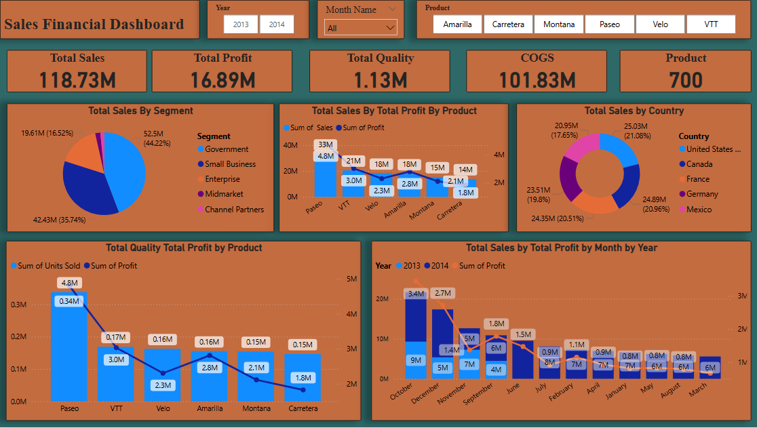
Dashboard Screenshot

Slide 10
THANK YOU

